Slide 1
WALMART SUPERSTORE SALES ANALYSIS Sherine Judith D.

Slide 2


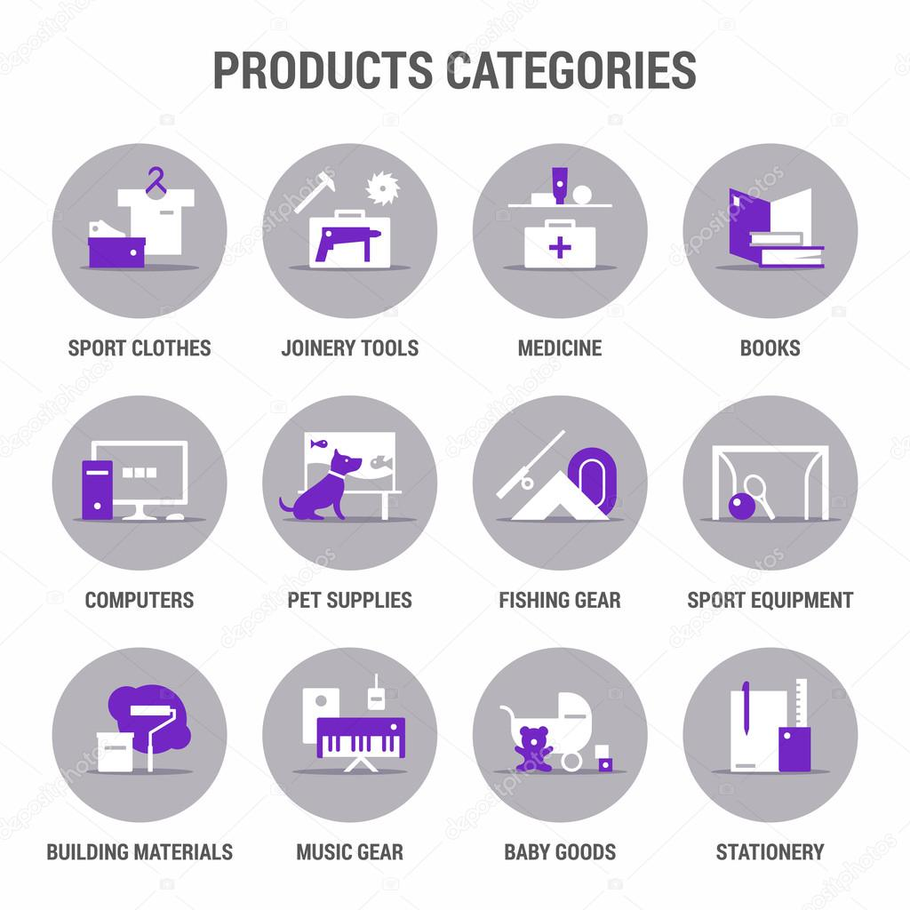

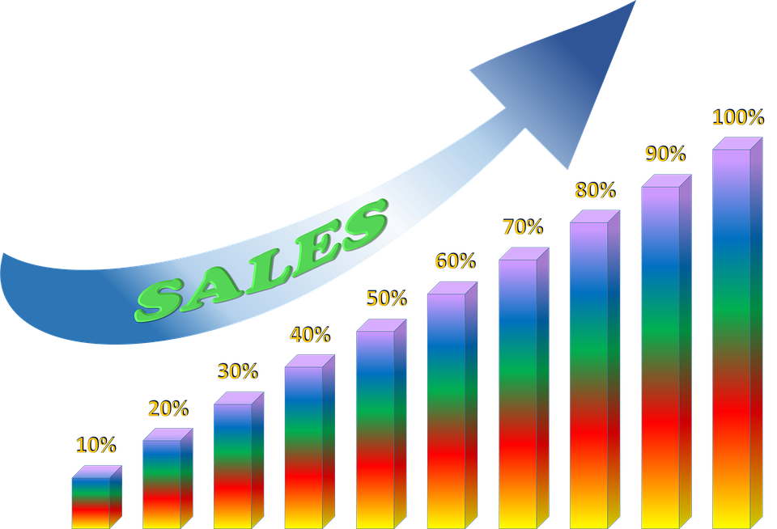

Insights
INSIGHT

Slide 3
Primary Analysis
Region-wise Performance Analysis:
Identify regions with the highest and lowest sales performance.
Analyze profitability in each region to understand which regions contribute the most to the bottom line.
Product Category Analysis:
Determine which product categories are driving the majority of sales.
Identify high-margin products to prioritize in marketing and sales efforts.
Customer Segmentation:
Segment customers based on their purchasing behavior, such as frequency, order value, and product preferences.
Tailor marketing campaigns and promotions to target specific customer segments effectively.
Price Optimization:
Analyze pricing strategies for different products and regions to ensure competitiveness without sacrificing profitability.
Consider dynamic pricing strategies based on demand, seasonality, and competitor pricing.
Inventory Management:
Optimize inventory levels to prevent stockouts of high-demand products.
Identify slow-moving or obsolete inventory and consider discounting or liquidating to free up capital and storage space.

Slide 4
Customer Experience Enhancement:
Focus on delivering exceptional customer service to enhance customer satisfaction and loyalty.
Collect customer feedback and use it to improve products, services, and overall shopping experience.
Cross-Selling and Upselling:
Implement cross-selling and upselling techniques to encourage customers to purchase complementary or higher-value products.
Leverage data analytics to identify opportunities for cross-selling and upselling based on customer purchase history.
Promotional Strategies:
Develop targeted promotions and discounts to incentivize purchases, especially during key shopping seasons.
Experiment with different promotional channels, such as email marketing, social media, and partnerships, to reach a broader audience.
Market Expansion:
Explore opportunities to expand into new markets or regions with high growth potential.
Conduct market research to understand the needs and preferences of potential customers in new markets.
Investment in Technology:
Invest in technology solutions such as customer relationship management (CRM) systems, e-commerce platforms, and data analytics tools to streamline operations and improve decision-making.

Slide 5
Shipping Methods: Different shipping methods, such as Standard Class, Second Class, and Same Day, are used for delivering orders, indicating flexibility in shipping options.
Customer Segments: The sales data includes transactions from various customer segments, including consumers, corporate clients, and home offices, suggesting a broad customer base.
Profitability Analysis: The document allows for profitability analysis by examining the relationship between sales revenue, costs, and profits across different product categories and regions.
Seasonal Trends: By analyzing the sales data over time, seasonal trends in sales volume and revenue can be identified, helping in forecasting and planning.
Opportunities for Improvement: The data may reveal areas where sales performance can be improved, such as optimizing pricing strategies, enhancing product offerings, streamlining logistics, and targeting specific customer segments more effectively.

Slide 6
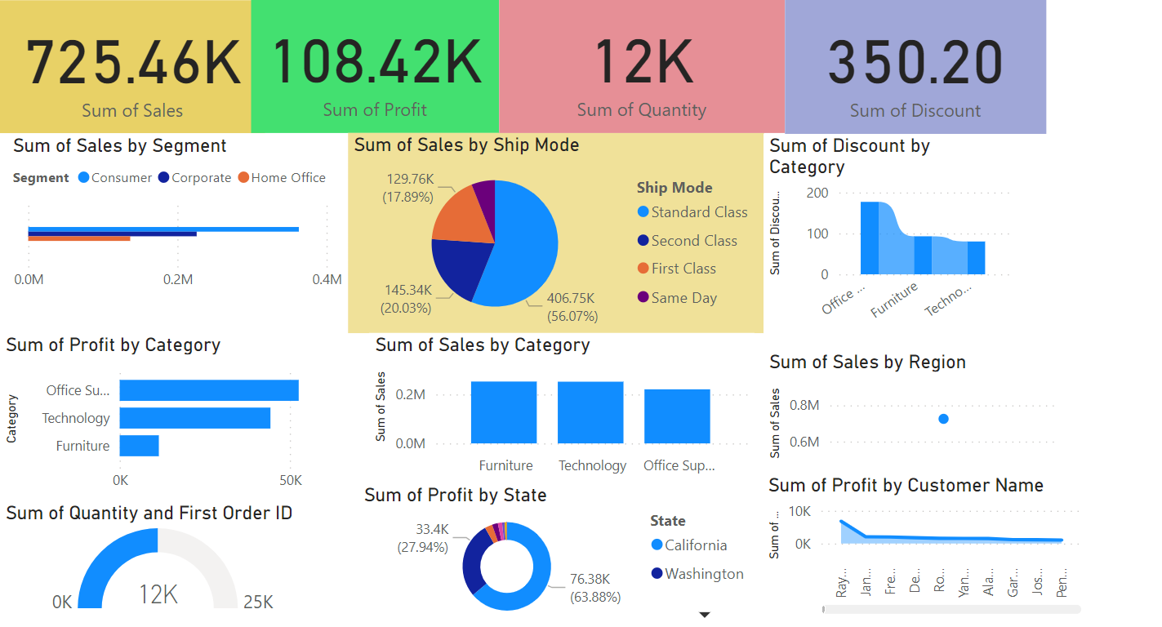
Sales Dashboard

Slide 7
REPORT AND SUGGESTIONS
SALES PERFORMANCE:
Top selling item, California market.
ANALYSIS OF PRODUCT:
High sale period,top selling category,best selling product.
PROFIT ANALYSIS :
Profit trends,profitability.
Improve onlineshopping, price optimization, innovative ideas, production publicity,personal selling.

